Slide 1
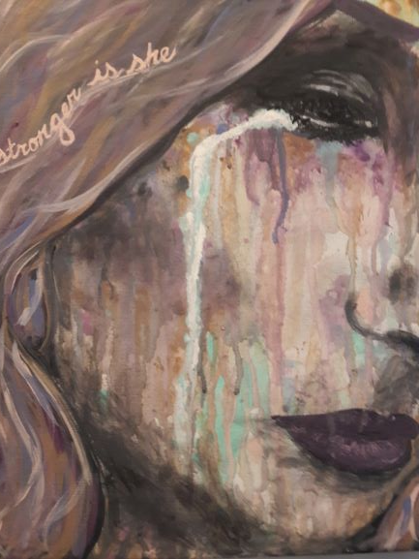
Annual Sponsorships Project Safe, Inc.
706-549-0922
www.project-safe.org
P.O. Box 7532, Athens, GA 30604
SPONSORING US
“Thank you so much for everything. I am a different person than when I first came here. I learned to let go.”
- Former shelter resident
THE NEED
The state of Georgia has lost 1,516 residents to domestic violence between 2011 and 2020. The majority were attempting to leave the abusive relationship. In roughly half of the cases, the victim began the relationship with the person who killed her when she was between the ages of 13 and 24. In the United States, 1 in 3 adolescents experience abuse from a dating partner.
THE SERVICES
Project Safe is an Athens-based nonprofit organization working to end domestic violence through crisis intervention, ongoing supportive services, systems change advocacy and prevention and education in the community. Our compassionate, flexible, and comprehensive services save and change thousands of lives each year. These services including everything from our hotline, teen text line, emergency shelter, emergency relocation, assistance with temporary protective and stalking orders, to individual group counseling, pet shelter, and transitional housing.
THE IMPACT
In 2022, Project Safe answered 2714 crisis calls, sheltered 123 adults and children, assisted 616 outreach clients at our outreach office, and delivered more than 130 in person and virtual trainings/presentations.
THE RESULTS
In anonymous surveys, 88% of clients report Project Safe services met their needs, 99% learned strategies to enhance their safety, and 94% gained knowledge about available resources. 85% of clients achieved safe housing or reached their housing goals, while 56% achieved their employment goals, and 90% achieved other goals they set for themselves while working with Project Safe.
“Gracias, son unos angelos, de Dios, las bendigo y les aprecio mucho por todo.” [Thank you. You are all angels of God, I bless you and appreciate you for everything.]
– Spanish-speaking outreach client
THE OPPORUNITY
90 cents of every dollar donated goes to victims and survivors of domestic violence. Whether it’s coordinating a late-night escape for a woman whose husband promised to make good on his threats to kill her, counseling for the teen consumed by rage and guilt after witnessing years of abuse, or shelter for a pet so a child doesn’t have to leave a beloved animal behind in the hands of an abuser, the services funded by your generosity will help people in our community escape the pain and devastation of abuse in the home.

Slide 2
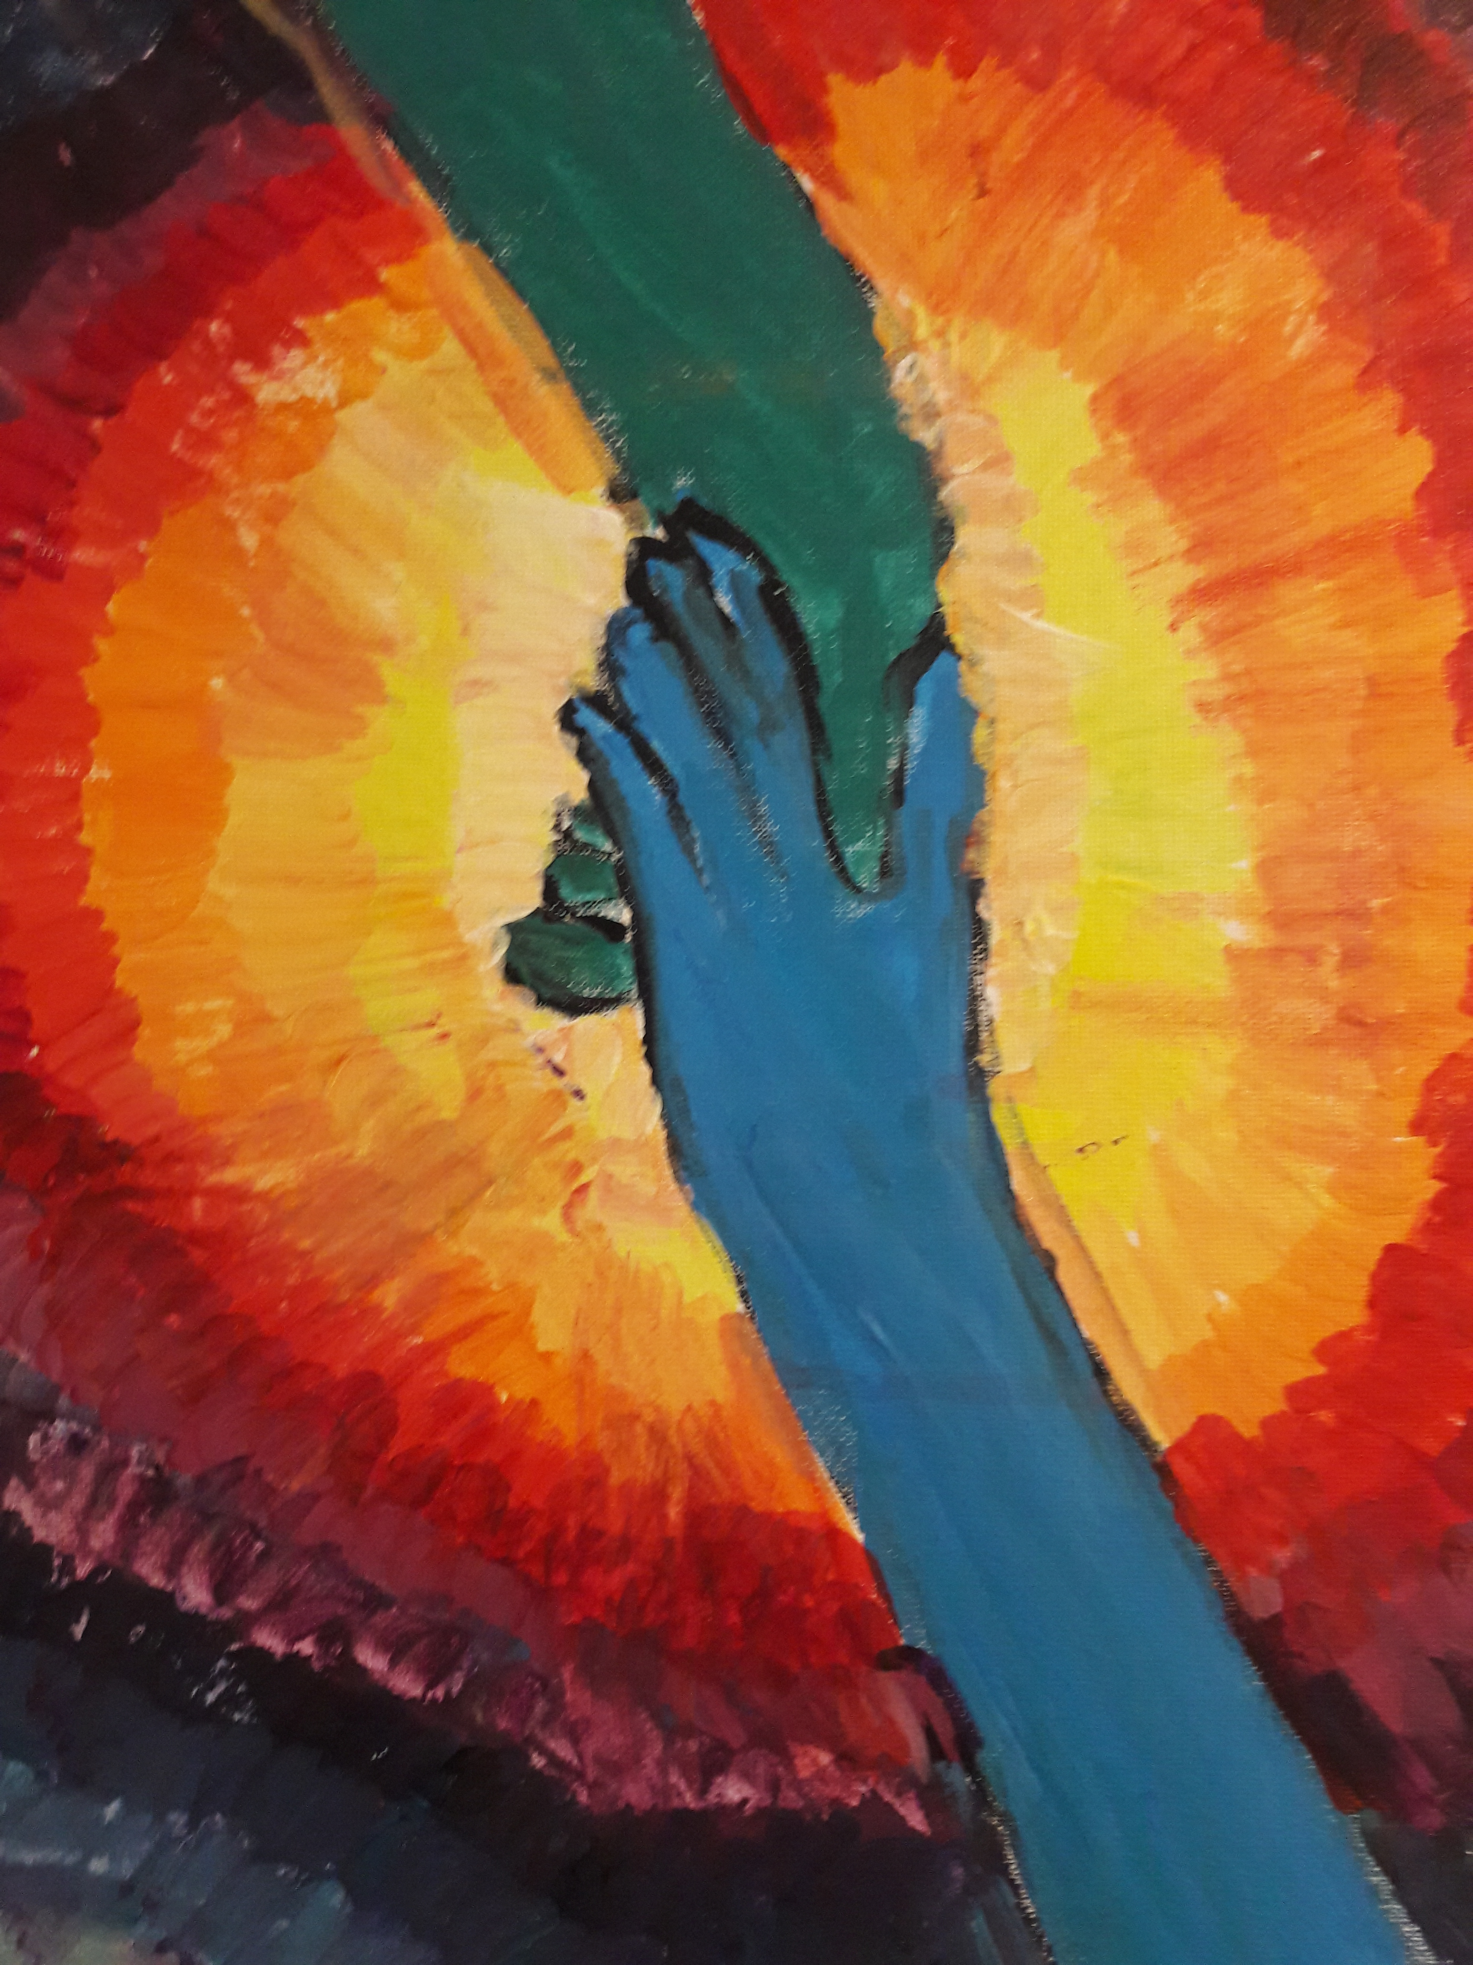
BENEFITS & RECOGNITION
Champion | $10,000
Top recognition on website sponsor button with hyperlinked logo
Personalized thank you video from staff
Logo recognition on Dancing with the Athens Stars video
Rotating recognition in regular weekly Flagpole ads
Individual social media “shout out” with link to sponsor website during DV awareness month (October), Crime Victims’ Rights Week (April), and two other dates (posts with sponsor personalization and collaboration)
Interview/article in our newsletter
Top logo recognition at all fundraising events
10 tickets to Dancing with the Athens Stars VIP reception
10 tickets each to Dancing with the Athens Stars & Groovy Nights
LEVELS:
Champion - $10,000
Partner - $5,000
Advocate - $2,500
Ally - $1,000
Supporter – $500
Friend - $250
TERMS & PAYMENT:
Please pay prior to 1/31/24 to ensure proper recognition in publicity materials. Make checks payable to Project Safe and mail to P.O. Box 7532, Athens, GA 30604.
Partner | $5,000 cash, $10,000 in kind
Recognition on website sponsor button with hyperlinked logo
Personalized thank you video from staff
Rotating recognition in regular weekly Flagpole ads
Individual social media “shout out” with link to sponsor website during DV awareness month (October), Crime Victims’ Rights Week (April), and two other dates (posts with sponsor personalization and collaboration)
Interview/article in our newsletter
Prominent logo recognition at all fundraising events
6 tickets to Dancing with the Athens Stars VIP reception
6 tickets each to Dancing with the Athens Stars & Groovy Nights
Advocate | $2,500, $5,000 in kind
Individual social media “shout out” with link during October and April
Newsletter shout out
Prominent logo recognition at all fundraising events
4 tickets to Dancing with the Athens Stars VIP reception
4 tickets each to Dancing with the Athens Stars & Groovy Nights
Ally | $1,000
Individual social media “shout out” with link to sponsor website during DV awareness month
Newsletter shout out
Prominent name recognition at two events of sponsor choice
4 tickets to Dancing with the Athens Stars VIP reception
4 tickets each to Dancing with the Athens Stars & Groovy Nights
Supporter | $500
Name recognition at one event of sponsor choice
Newsletter shout out
4 tickets to Dancing with the Athens Stars or Groovy Nights
Friend | $250
Name recognition at one event of sponsor choice
Newsletter shout out
2 tickets to Dancing with the Athens Stars or Groovy Nights

